Slide 1
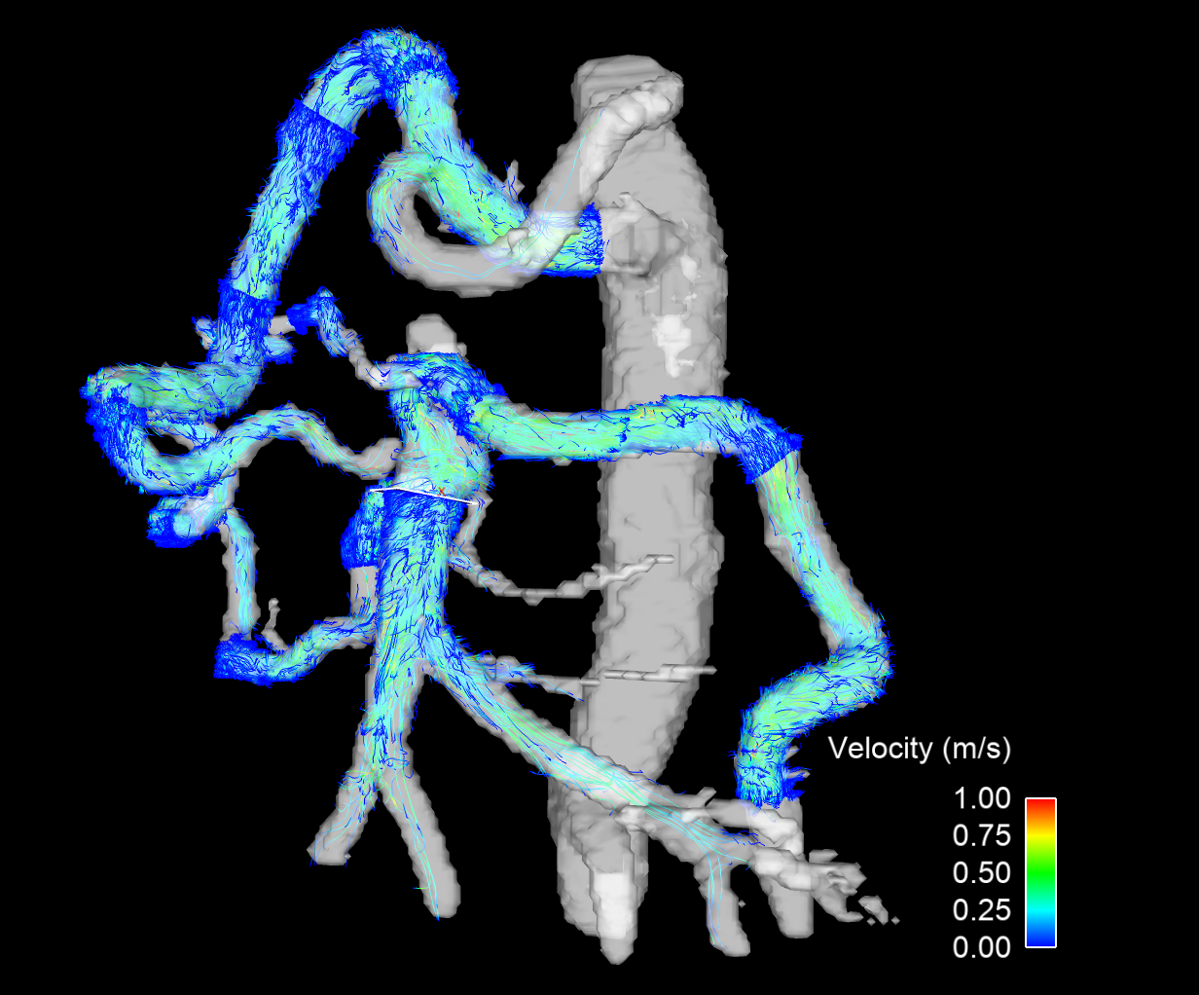
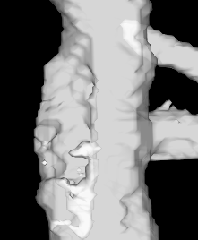
GDA
Aortic coarctation
SMA occlusion
Arc of Riolan
Distal SMA
IMA

